Slide 1



Forest NPP: Examining spatial and temporal heterogeneity within the LTER Network
Mark E. Harmon (AND), John Battles (HBR), Audrey Barker Plotkin (HFR),
Jim Clark (CWT), Grizelle González (LUQ), Michelle Mack (BNZ)
Scott Ollinger (HBR, HFR), Roger Ruess (BNZ), and Jonathan Thompson (HFR)
March 5, 2015

Slide 2
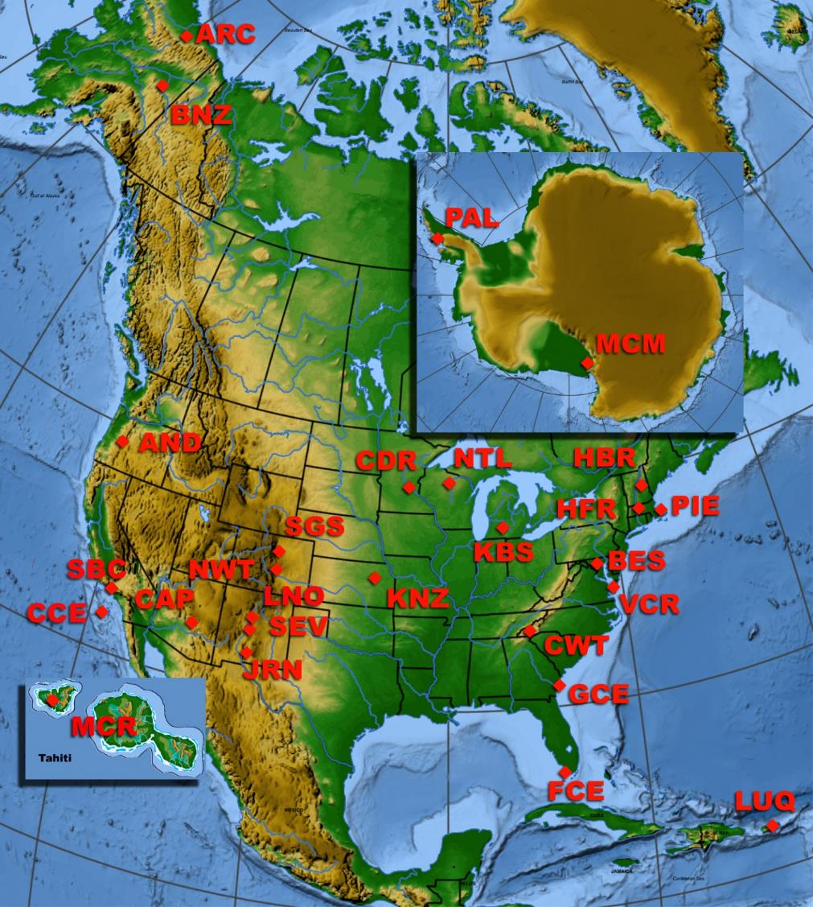
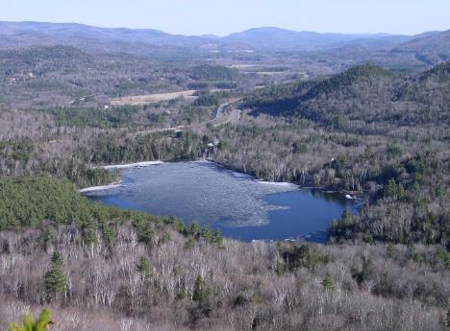
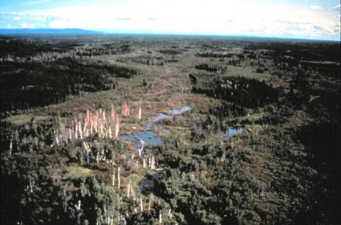
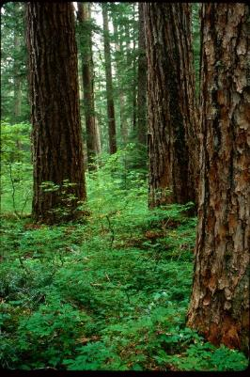
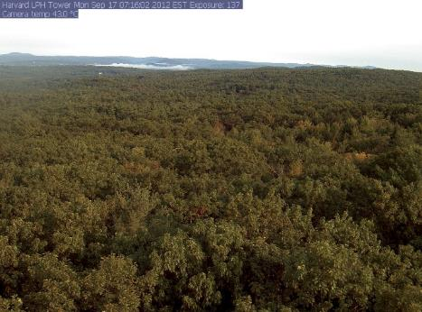
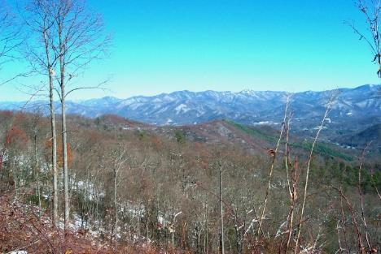
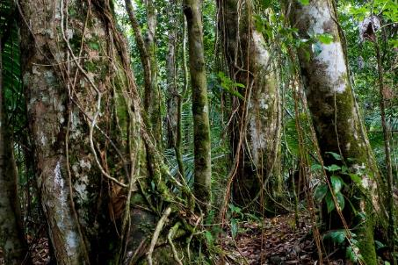
Notes:
The location of LTER’s dominated by forest ecosystems are shown.

Slide 3
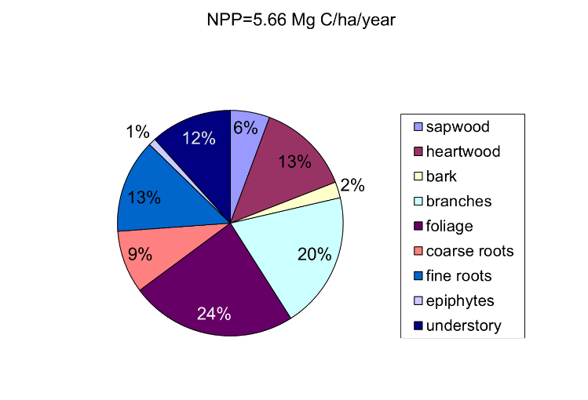
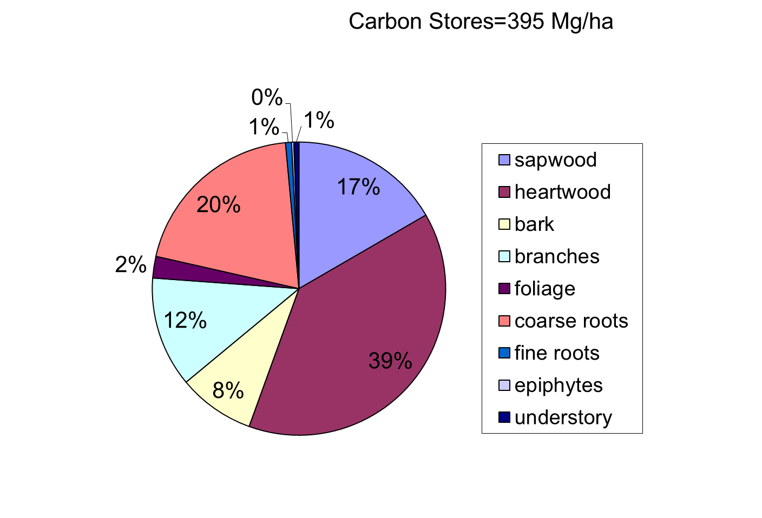
What do we mean by forest NPP?
NPP_{total}
42-78% Aboveground
10-50% Wood_{AG}
Biomass_{Total}
70-96% Aboveground
62-94% Wood_{AG}
Total NPP-not often measured
Aboveground NPP-more likely to be measured
Woody NPP- most likely to be measured
Ruess RW, et al. (2003) Ecological Monographs 74:643-652.
Harmon et al (2004) Ecosystems 7:498-512
Notes:
Forest NPP can mean different things. While the NPP allocated to wood is not the majority, it is where most of the biomass accumulates.

Slide 4
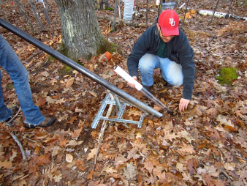
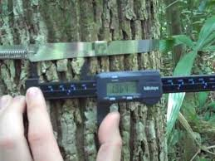
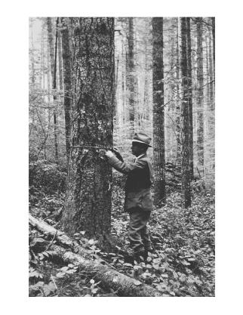
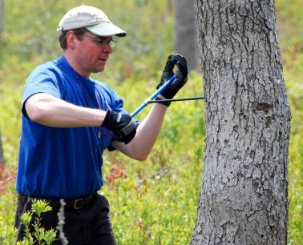
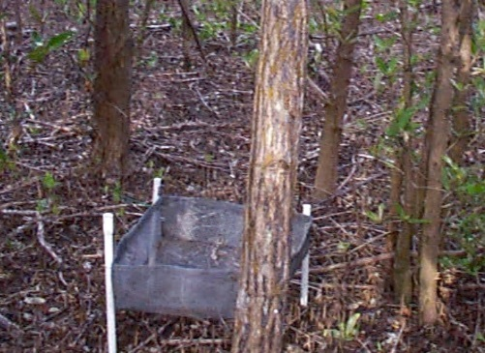
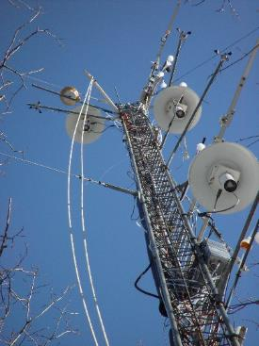
Forest NPP is measured by:
Repeated measurements
  Diameter, mortality
  litter traps
  Roots: sequential coring
  and mini-rhizotrons
Reconstructions- increment coring
Indirect- eddy covariance estimates of GPP
Photo: R. Abramoff
Photo: Harvard Forest
Photo: Harvard Forest
Notes:
The diversity of ways that NPP is measured and estimated creates some challenges in terms of synthesis because we need to compare comparable measures.

Slide 5
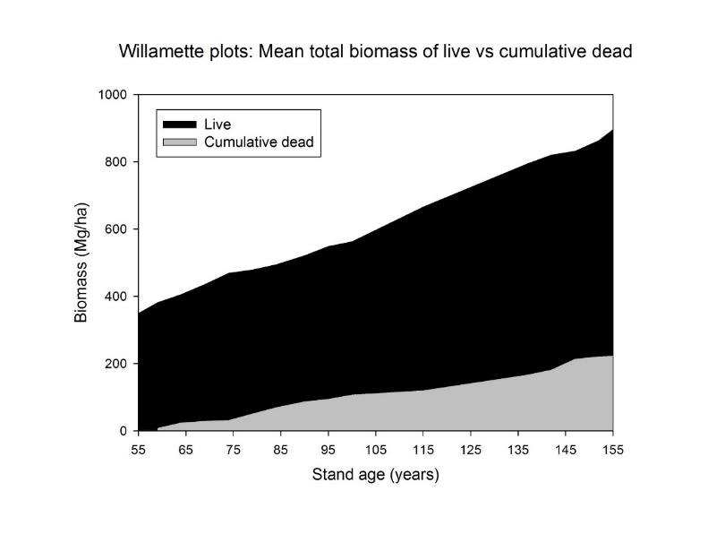
Limits of reconstructions
Reconstructed Observed
NPP_{wood} 5.51 Mg/ha/y 7.44 Mg/ha/y
35% greater
Source: Harmon and Pabst (2015) J. Veg. Sci.
Thornton T. Munger
Notes:
Reconstructions have limitations, the largest being that production that is “removed” via mortality cannot be accounted for. The seriousness of this problem increases the farther back in time one tries to go.

Slide 6
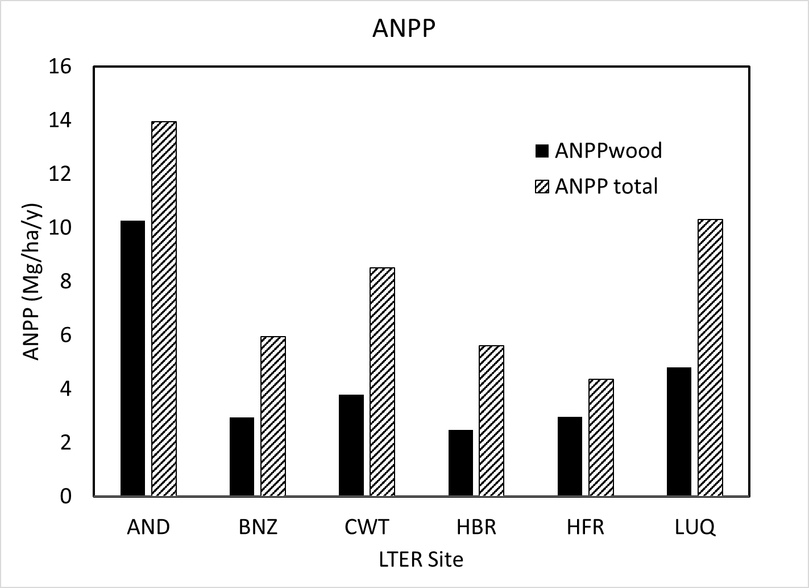
Site Variability in ANPP
Notes:
This figure displays the “average” ANPP for wood and total aboveground parts for the six forest sites. Note that the most productive site is not a tropical forest, but a temperate evergreen one (AND) which also has a very large allocation to wood production.

Slide 7
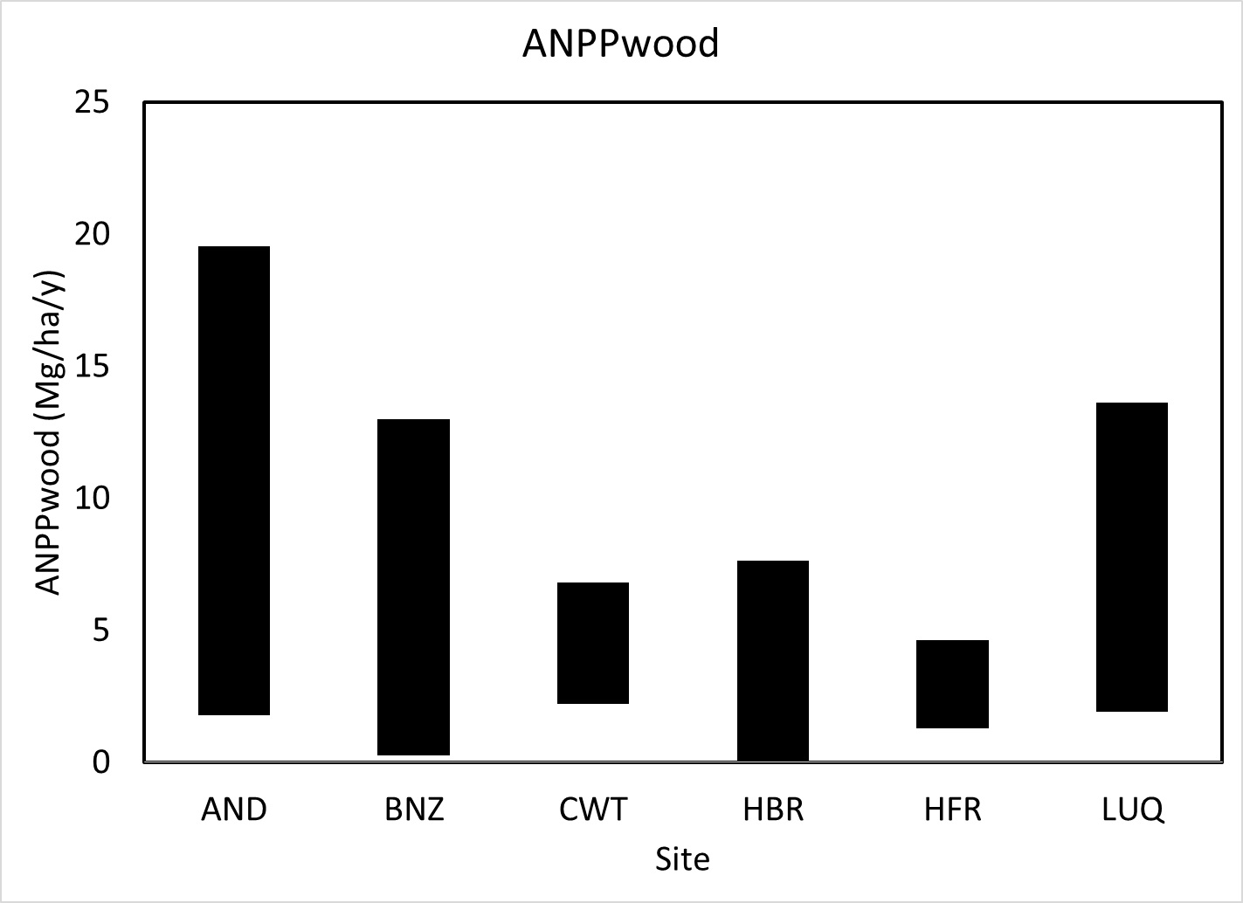
Within site variability is as high as between
Notes:
The range in variation in aboveground woody-related NPP is very large within sites. This means one needs to pay special attention to how representative data is selected.

Slide 8
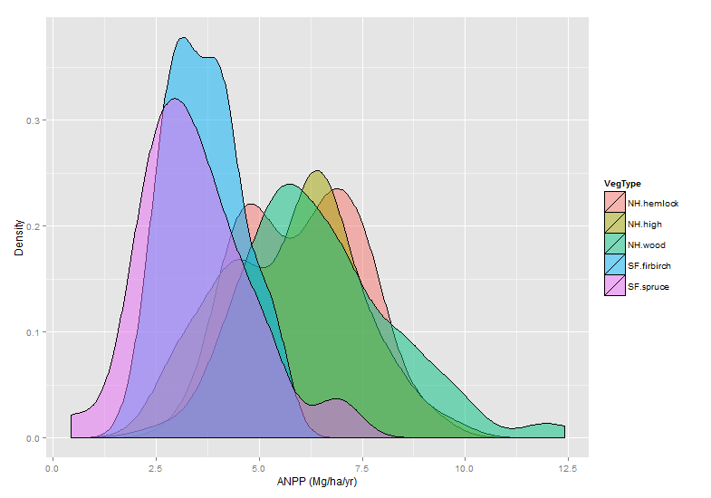
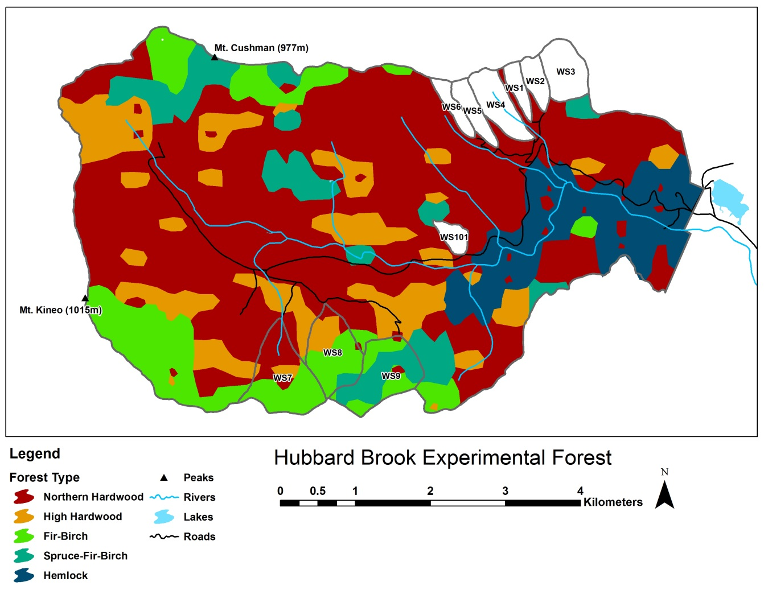
Valley-wide spatial variability in ANPP in Hubbard Brook Valley by forest type.
Data from tagged tree inventory: 1995/96 to 2005/06.
VegType | mean | sd | N | se
NH.hemlock | 6.0 | 1.4 | 52 | 0.2
NH.high | 5.7 | 1.6 | 98 | 0.2
NH.wood | 6.5 | 1.8 | 140 | 0.2
SF.firbirch | 3.7 | 0.9 | 41 | 0.1
SF.spruce | 3.5 | 1.3 | 40 | 0.2
Notes:
Landscape scale variability in ANPP at Hubbard Brook. Research watersheds excluded from summary. Includes entire 30,000 ha valley with five distinct forest types. The forest is second-growth with harvest disturbance in 1917, hurricane+salvage disturbance in 1938-1940.

Slide 9
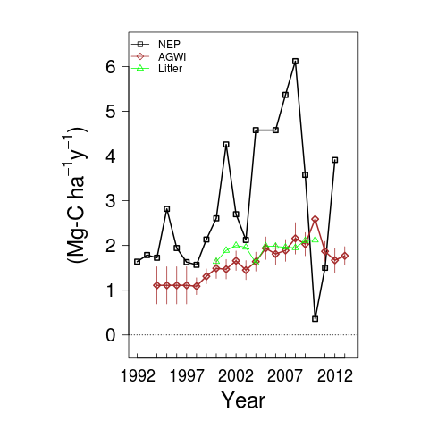
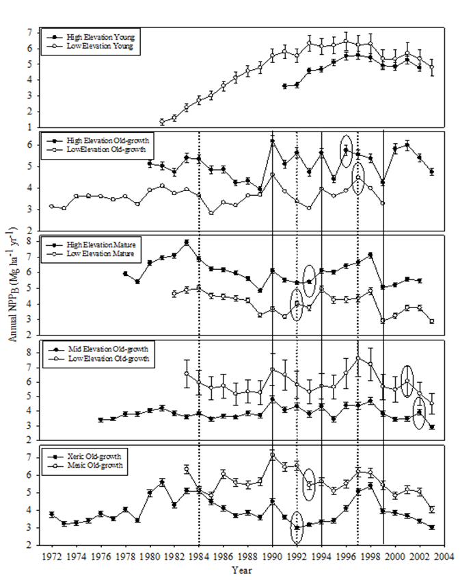
Temporal variability in ANPP_{wood}
AND
Solid line-similar response
Dashed line- dissimilar response
Ellipse- possible lagged response
HFR
CV= 10-35%
Source: Bill Munger-HFR
Source: Woolley et al 2015 Forest Ecology & Manag
Notes:
NPPwood also varies over time. Here are two examples of year-to-year variation. Work at the Andrews indicates the CV of NPPwood ranges from 10-35% depending on the site. What is more curious is that with very few exceptional years, the year-to-year variation is not well correlated among the sites.

Slide 10
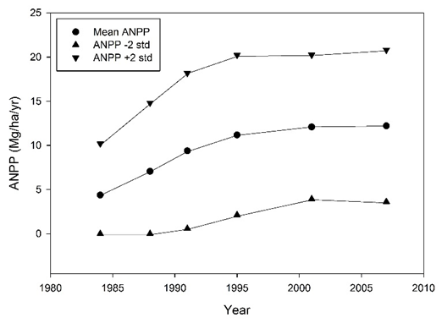
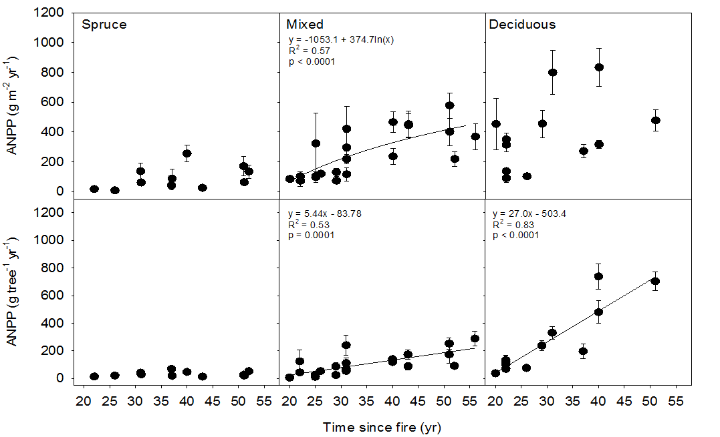
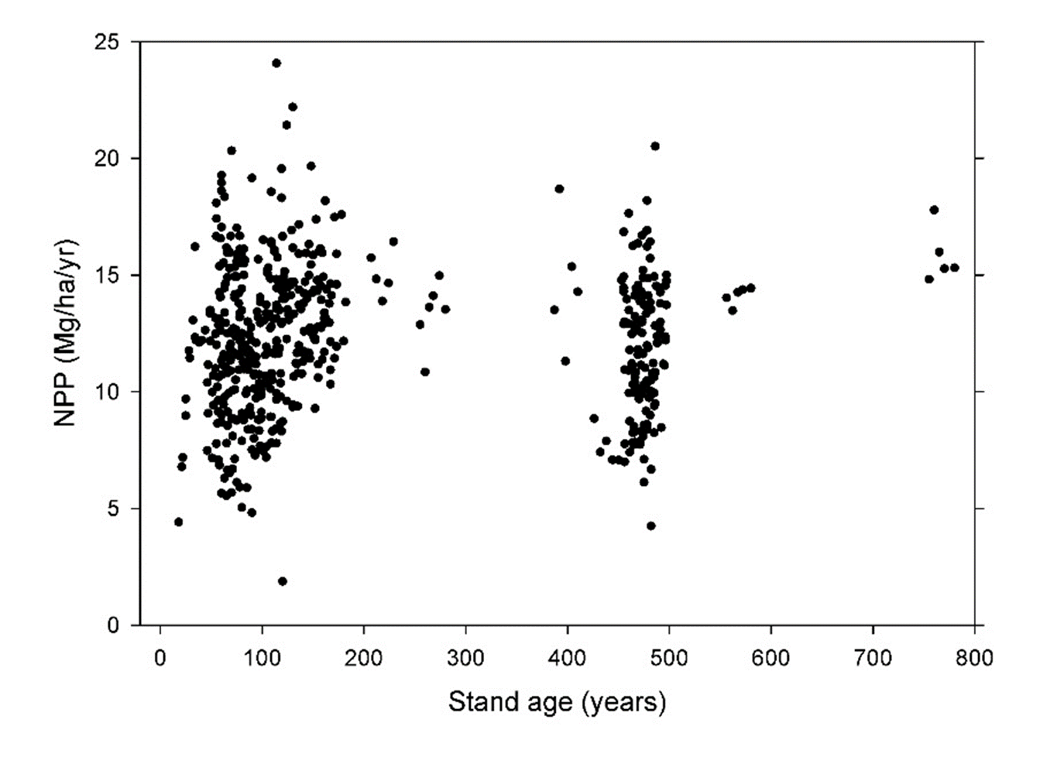
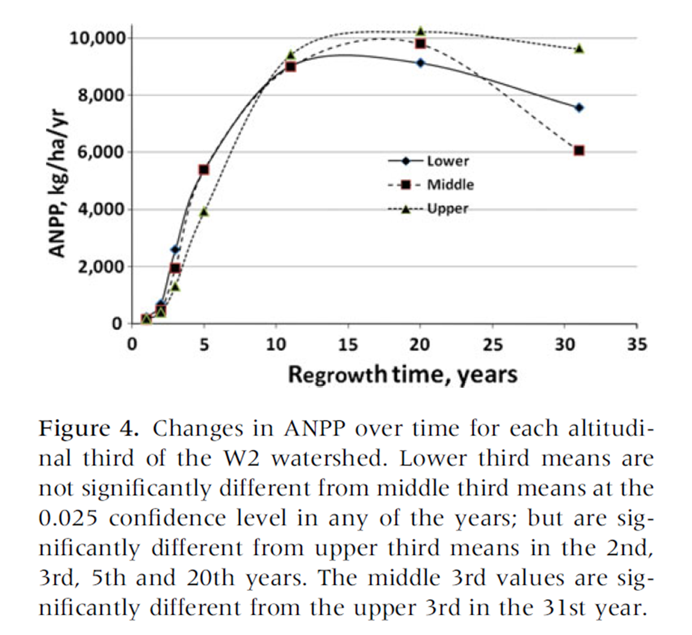
How variable is forest NPP over succession?
AND
BNZ
Harmon and Fasth unpublished
Source: M. Mack
AND
HBR
Harmon and Pabst unpublished
Source: J. Battles
Notes:
There is also considerable temporal variation in NPP following a major disturbance. For some forest ecosystems NPP can reach a maximum in as little time as a decade, but others it may take over 50 years. Another facet is that some ecosystems exhibit a decline after the peak in NPP and others do not.

Slide 11
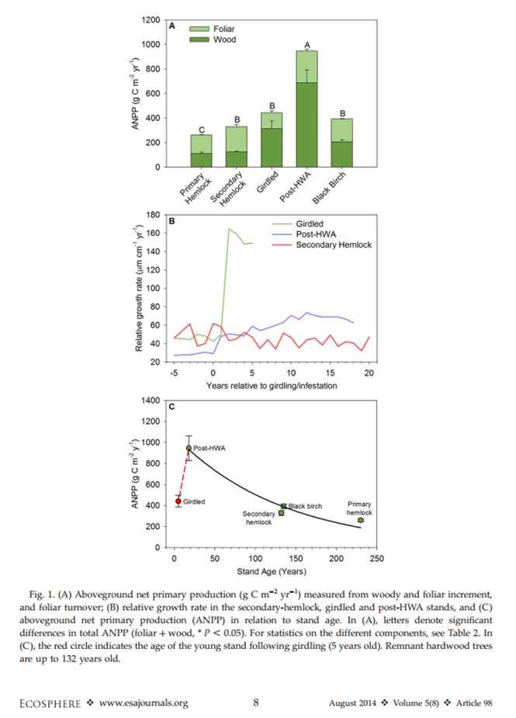
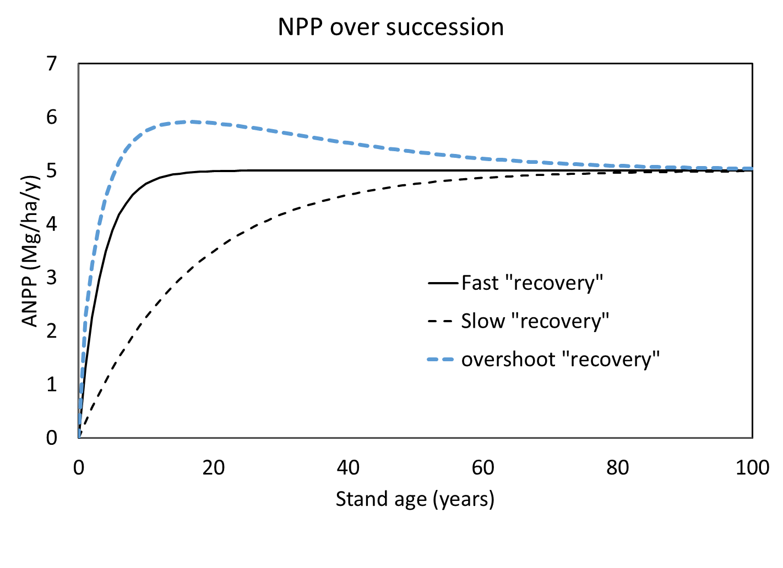
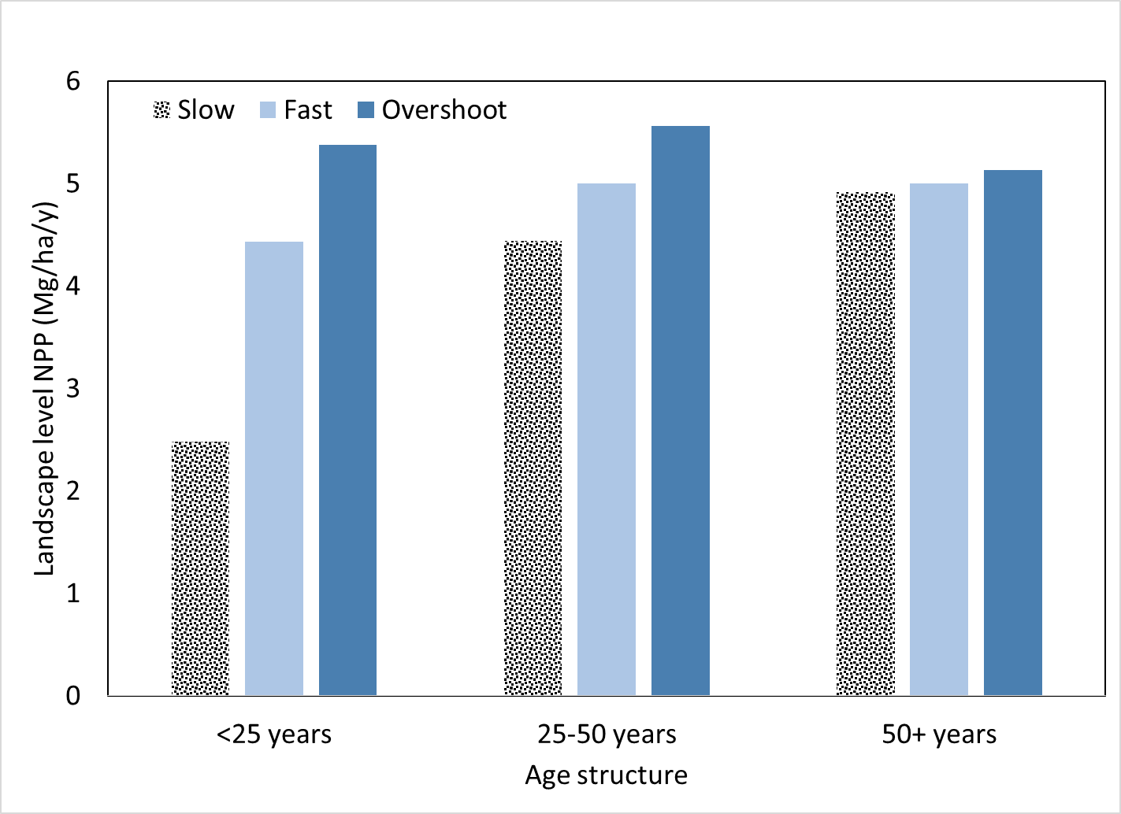
Disturbance Influences ANPP at stand
and landscape levels
Raymer & Finzi (2014)
Notes:
The fact that disturbance influences NPP means that the age-structure of a forest can influence the NPP value at the landscape level. For example, as hemlock woolly adelgid kills stands in New England it is anticipated that NPP will increase. We can look at these effects by examining three possible theoretical trajectories of NPP after disturbance. The age structure of forests has a great influence on the differences one detects in this trajectories: they become more similar as forests become older. It is also possible that forests can have the same trajectory, but different age-structures can lead to different average NPP if the age structure is young versus old.

Slide 12
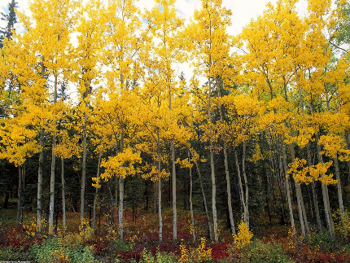
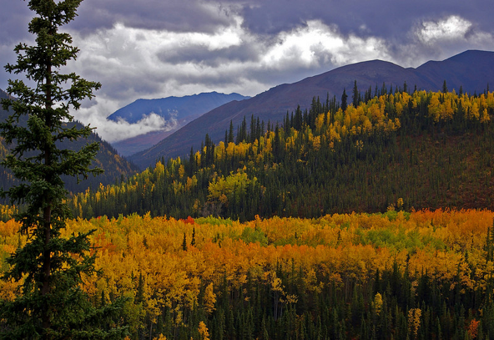
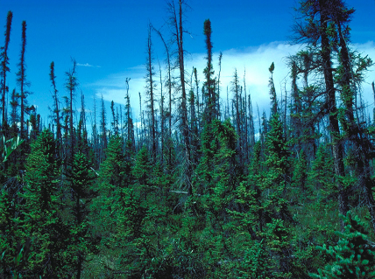
The distribution of ecosystem types
Influences ANPP of trees/large shrubs
~60 g C m⁻² yr⁻¹
~140 g C m⁻² yr⁻¹
~240 g C m⁻² yr⁻¹
Source: M. Mack BNZ
Notes:
The distribution of ecosystem types in a forest landscape can have a major influence on average NPP. In this example from BNZ one can see very different levels of NPP for black spruce, aspen, and birch dominated ecosystems. A change in the abundance of these ecosystems such as mostly black spruce to mostly birch could lead to a 4-fold increase in NPP.
Prod 2-4x higher in deciduous stands.
BS = 60
Aspen = 140
Birch = 240

Slide 13
Aboveground litter production as a function of elevation in northeastern Puerto Rico
4
.
0
3
.
5
3
.
0
2
.
5
Total litterfall (g m⁻² d⁻¹)
2
.
0
1
.
5
1
.
0
0
.
5
0
.
0
0
1
0
0
2
0
0
3
0
0
4
0
0
5
0
0
6
0
0
7
0
0
8
0
0
9
0
0
1
0
0
0
Elevation (m)
Data in red from Weaver and Murphy (1986), Scatena et al. (1996), and Silver et al. (in prep).
Data in green from González (unpublished).

Slide 14
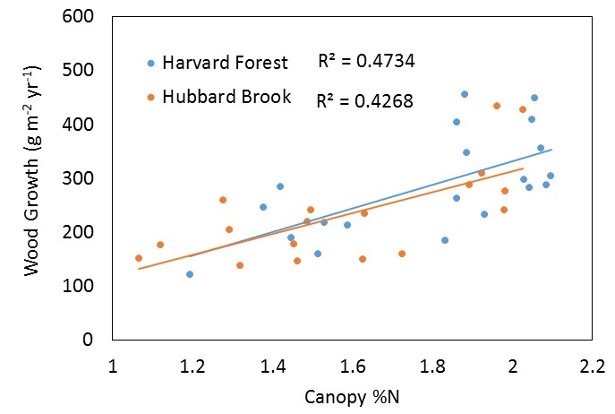
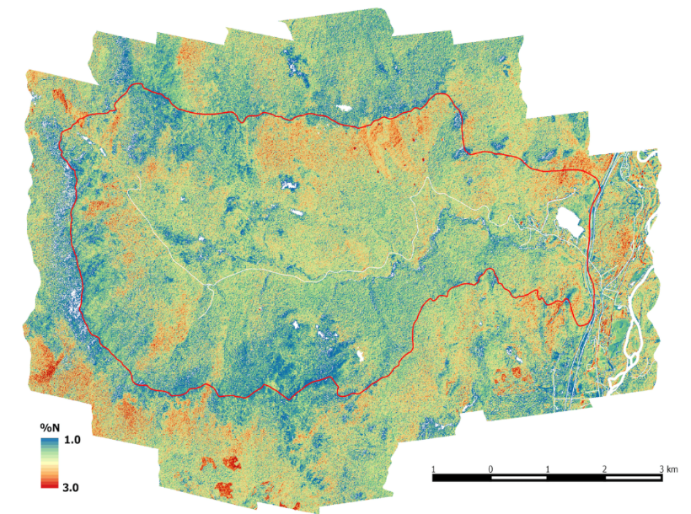
Canopy nitrogen in relation to wood NPP at Hubbard Brook and Harvard Forest
Canopy %N at Hubbard Brook
Measured wood growth at both sites are from repeat measurements of DBH. Data from HB were collected by J. Battles and data for HF are from the Bigfoot project.
Canopy %N is based on measured, mass-based foliar %N by species, averaged for each plot by proportional species abundance. Spatial patterns in %N are derived using field data calibrated to aircraft imaging spectroscopy.
Notes:
In the NE work at HFR and HBK has been using remotely sensed values of canopy %N to estimate landscape patterns of NPP

Slide 15
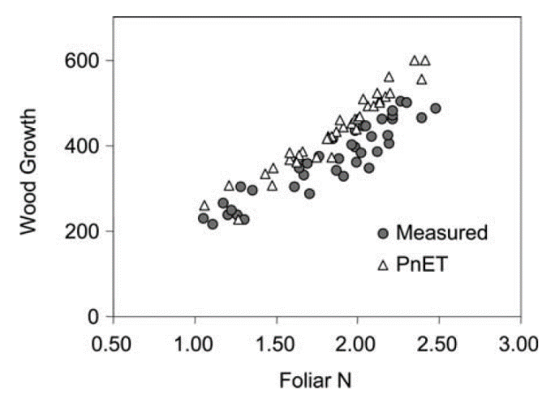
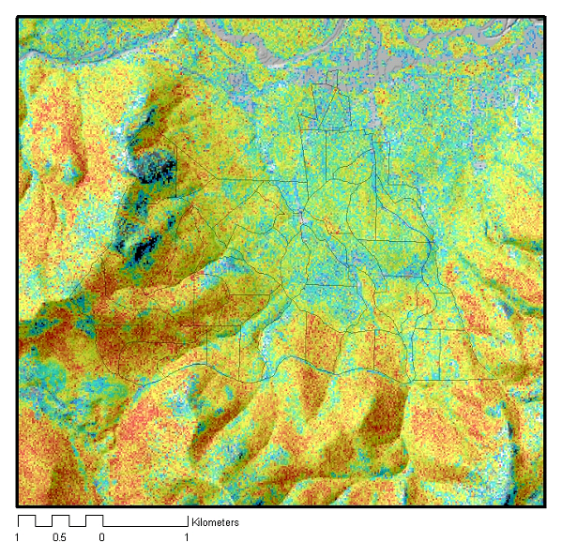
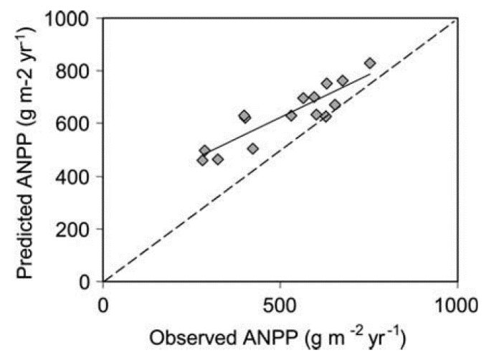
Canopy N and predicted NPP at the Bartlett Forest
(using the PnET ecosystem model)
< 700
800
900
1000
>1300
NPP
(g m⁻² yr⁻¹)
Ollinger and Smith, Ecosystems (2005)
Notes:
This is key to parameterizing models that can be used to examine spatial patterns of NPP and how these might change with an altered environment in terms of climate and nutrient availability.

Slide 16
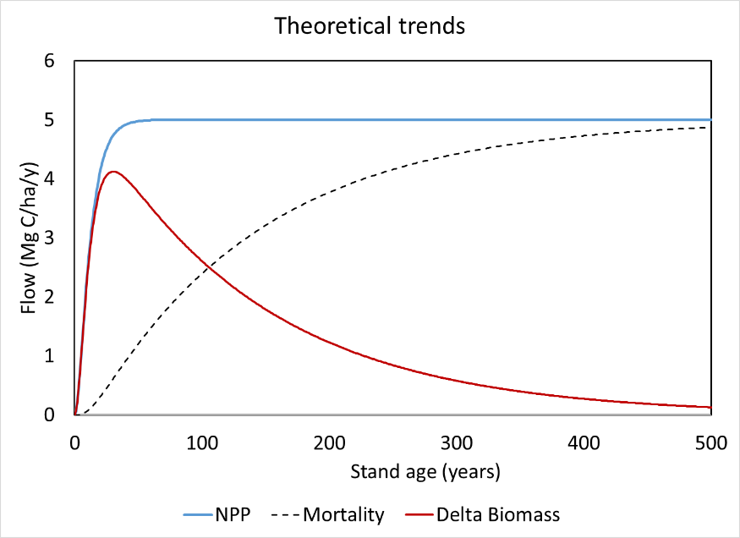
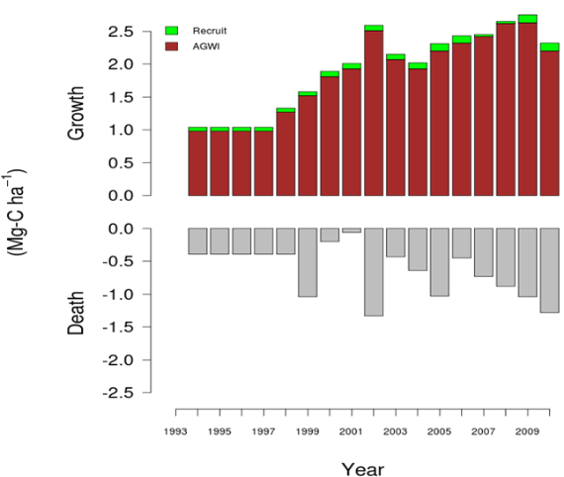

Where does NPP go?
The impact of NPP on live biomass depends not only on how much is coming in (NPP) but also on how much is going out (mortality)
Net accumulation versus mortality, as forests age, more and more should be going to mortality which leads to a slowing of the net accumulation of biomass
Notes:
We can’t just quantify NPP and assume that is the end of the story! We need to understand where it is going if we want to understand what forest ecosystems are doing.
In theory NPP increases and then asymptotes during succession, but the same is true for mortality. The result is that increment of NPP going into live biomass accumulation increases, but then falls off over time as more an more NPP is going to replace mortality.

Slide 17


NPP versus Mortality
Mortality requires long-term observations
Mortality limits ability to estimate NPP in the past (some of the past NPP has died and disappeared)
Mortality is inherently more variable in time and space
  by orders of magnitude
Mortality and NPP both influence the maximum live stores

Slide 18
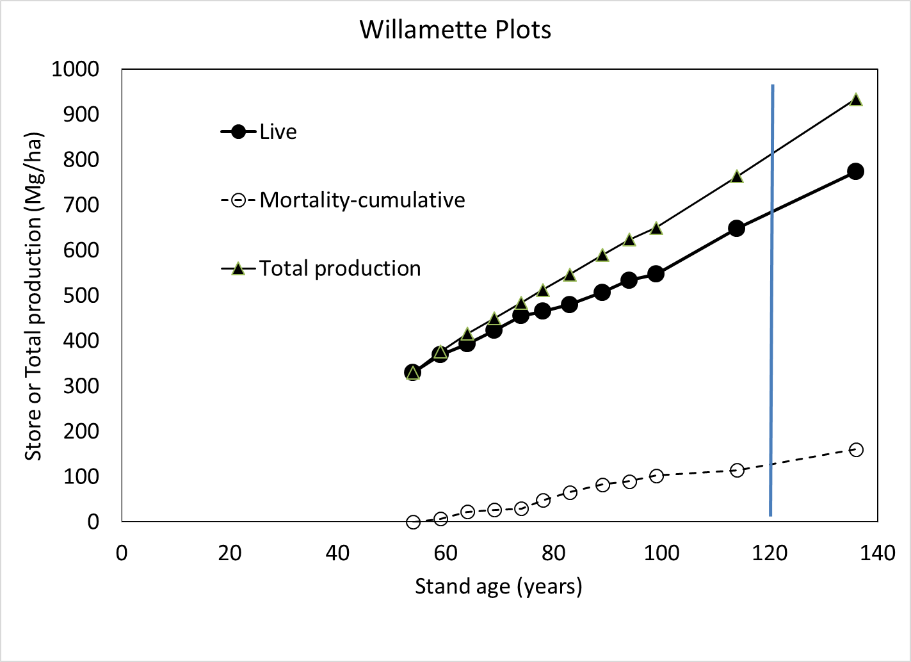
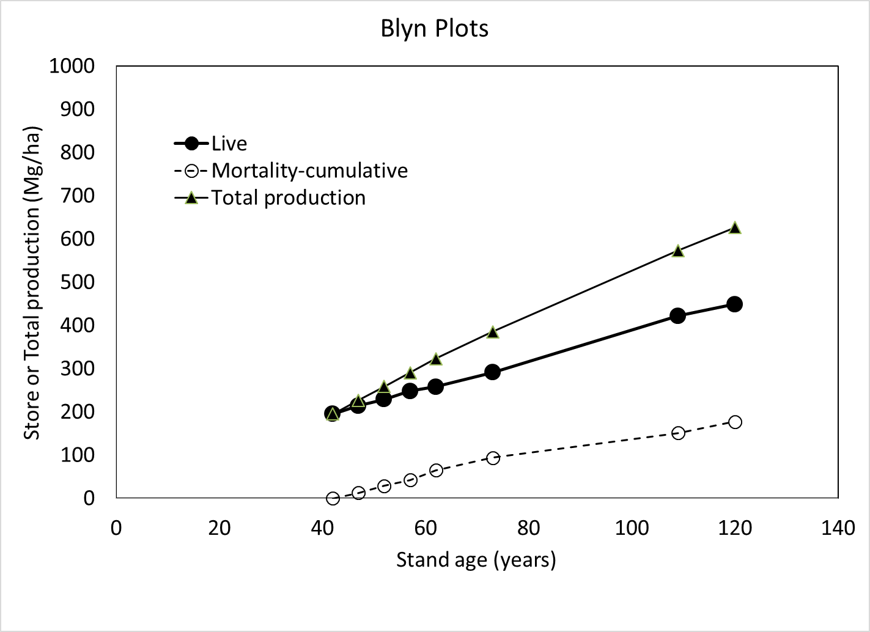
Consequences of mortality on biomass accumulation
NPP_{wood}= 7.36 Mg/ha/y
Mortality=17%
NPP_{wood}= 5. 56 Mg/ha/y
Mortality=28%
Source: Harmon and Pabst (2015) J Veg Sci
Source: Harmon and Pabst, unpublished
Notes:
The amount of NPP allocated to replacing mortality can make a large difference in how much live biomass accumulates. The difference in live biomass accumulation at 120 years is in part due to the fact the Willamette plots have a 32% higher NPPwood than the Blyn plots. But the difference in live biomass is 52%, caused by the higher allocation to mortality replacement at Blyn.

Slide 19
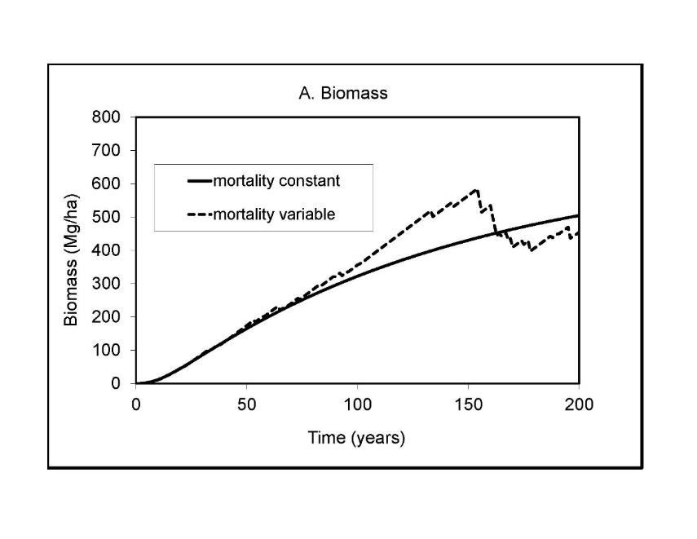
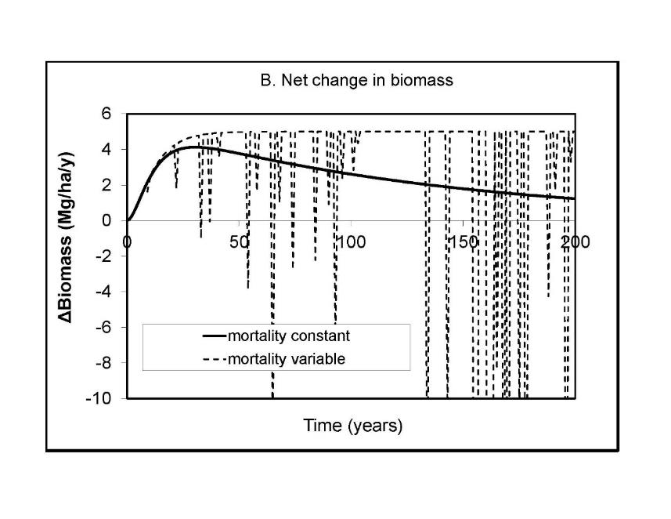
The heterogeneity in mortality has major impacts on how live biomass accumulates in forests
Source: Harmon and Pabst (2015) J Veg Sci
Notes:
Mortality by it’s very nature is heterogeneous especially compared to NPP. This has major consequences on how live biomass accumulates and also how the rate of biomass accumulation changes over time.

Slide 20
Conclusions
There is as much range in NPP within forest sites as between sites
  Use of data from typical stands could be misleading
  Quantifying a site average and variability more useful
Year to year variability in NPP_{wood} is 10-35% of long-term average
NPP_{wood} can be reduced 10-50 years following a major disturbance
The fate of NPP is important to consider
  Mortality is the key process determining whether and how live biomass accumulates
  Mortality is inherently variable relative to NPP which may lead to different expectations of how live biomass accumulates

Slide 21
Acknowledgements
This synthesis was supported by grants from NSF via the Long-term Ecological Research Program (DEB-0423259, DEB-1026415, DEB-1237491, DEB-1239764, and DEB-140409) and cooperative agreements with the US Forest Service. We thank the many people at the six sites that helped collect and analyze the data presented.

